Slide 1
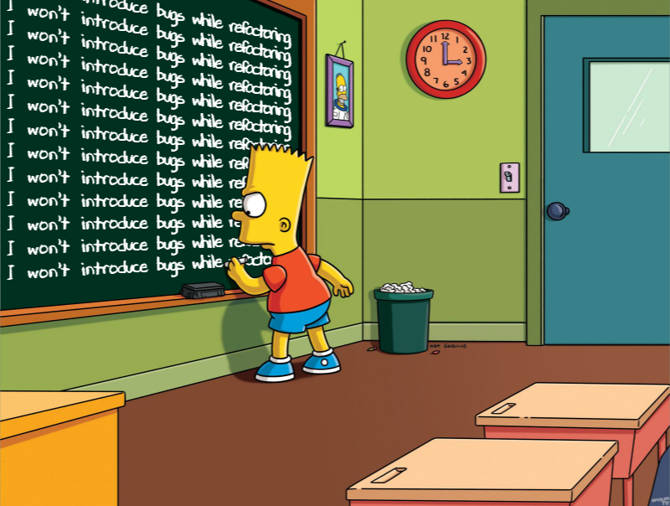
Let’s Make Long Methods a Thing of the Past
A Pragmatic Introduction to Refactoring

Slide 2
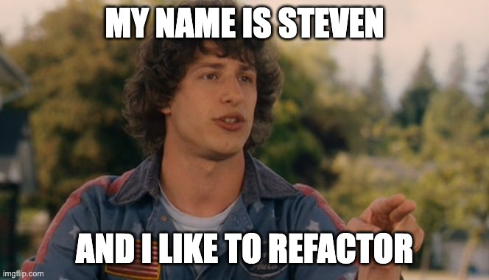
XP practitioner
Passionate about technical excellence
Love of learning and teaching
Organizer of Raleigh Software Craftsmanship Community

Slide 3
Learning Goals
Identify long methods
Apply appropriate refactorings to long methods
Explain to someone why refactoring is beneficial

Slide 4

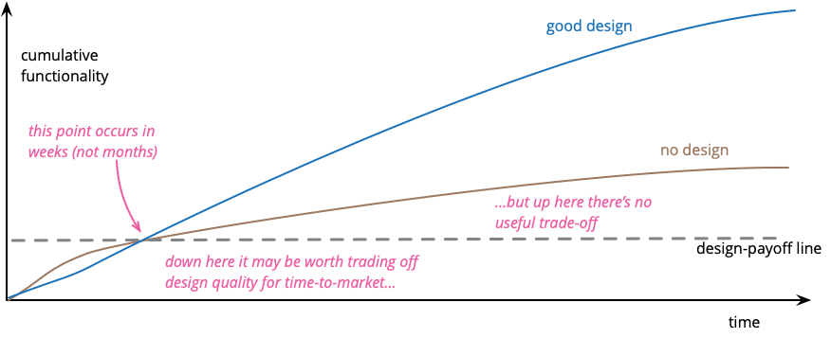
Refactoring
changing the structure of code
without changing its behavior
Refactoring improves the design of our code, making it easier to maintain and change in the future
Notes:
https://martinfowler.com/bliki/DesignStaminaHypothesis.html

Slide 5
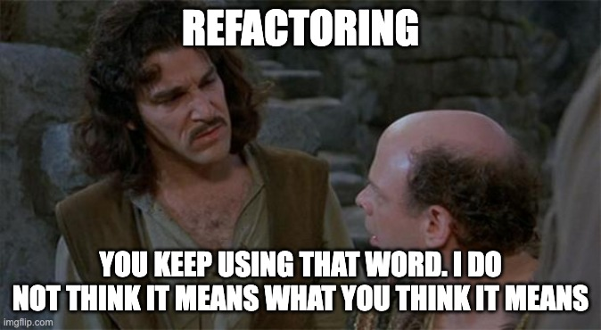
What refactoring is not?
Fixing bugs
Deleting code and rewriting it
Reworking a feature because you did it wrong the first time

Slide 6
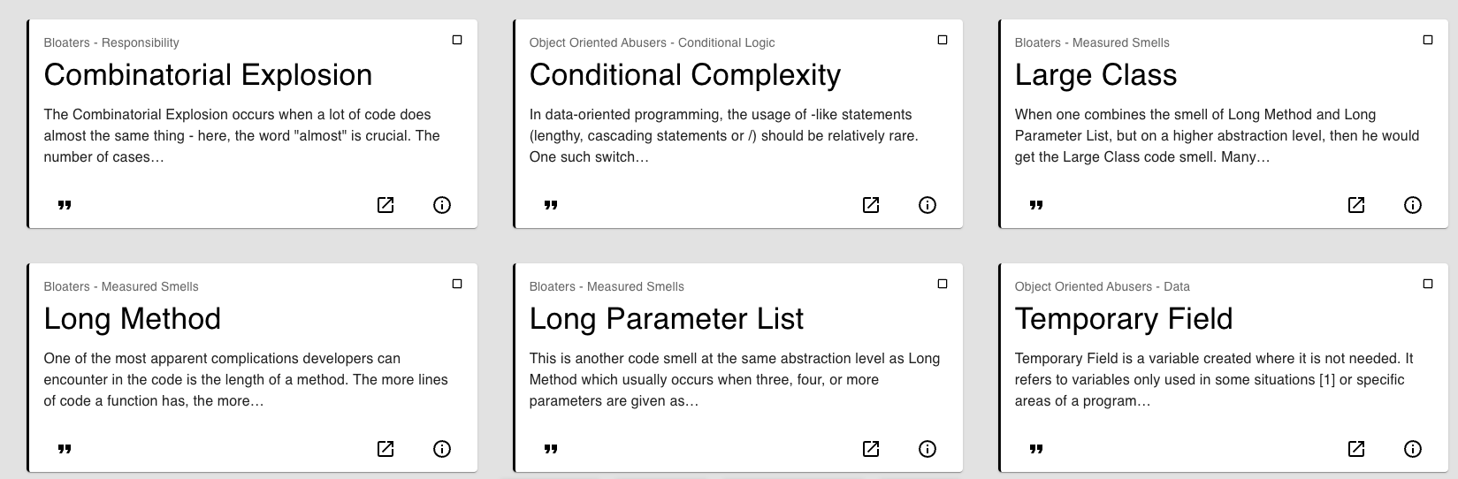
Code Smell
a symptom of a poor design or implementation choice
Notes:
https://luzkan.github.io/smells/ Code smells = problems
Refactoring = solutions
Code smells give us names that we can use to communicate with other developers about design flaws

Slide 7
How many lines makes a method too long?

Slide 8

How long is too long?
"The argument that makes the most sense to me, however, is the separation between intention and implementation. If you have to spend effort into looking at a fragment of code to figure out what it's doing, then you should extract it into a function and name the function after that 'what'."
- Martin Fowler (author of Refactoring)

Slide 9
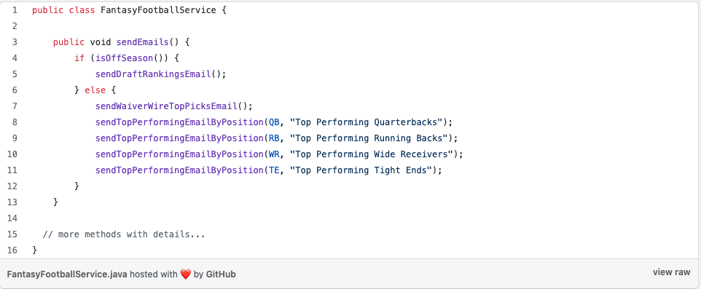
The Step-down Rule (Composing Method)
Notes:
"We want the code to read like a top-down narrative. We want every function to be followed by those at the next level of abstraction so that we can read the program, descending one level of abstraction at a time as we read down the list of functions. I call this The Stepdown Rule."
- Clean Code by Robert C. Martin

Slide 10



Why are long methods a code smell?
Methods should do only one thing
Communication with other devs
They are hard
to name
Notes:
Methods should do only one thing
Brains can only hold 4-6 pieces of information in its working memory
Communication with other devs
Short methods communicate intent very well
Your code tells a story
Because we work with others this makes everyone’s life easier
They are hard
to name
Long methods are hard to name because they do so many things
Inputs and outputs become clearer
Long methods hide away other code smells
so they are the first code smell I look to resolve

Slide 11
Refactoring Tips
Start with a high-quality test suite
Use automated refactorings when possible
Keep the tests passing the entire time
Do not change any behavior
Take small steps (aim for better, not perfection)
Commit frequently
Have a goal in mind while refactoring
Notes:
Share story about not having tests for demo previously
Do not change any behavior
Find a bug, tell the business and do it separately
Keep refactoring PR separate from behavior changing PR

Slide 12
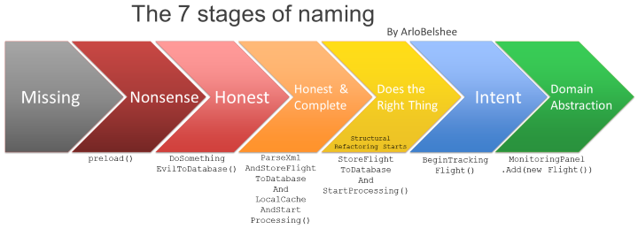
Naming as a process

Slide 13
How to eliminate long methods
Identify a code paragraph
Extract a method
Give it a descriptive name
Repeat
Notes:
Code Paragraphs Sparrow Decks Long Method Code Smell

Slide 14
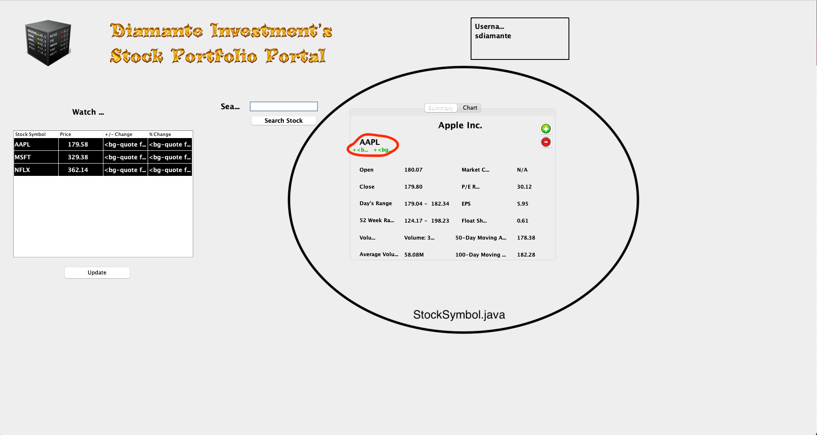

Slide 15
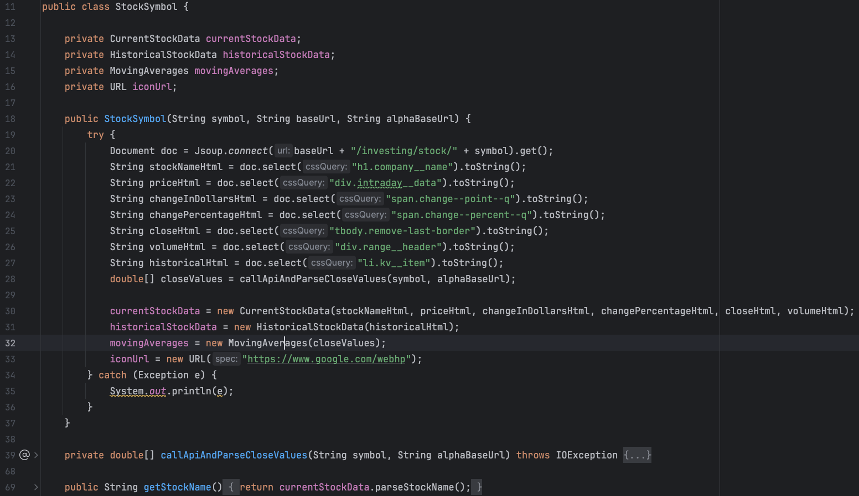
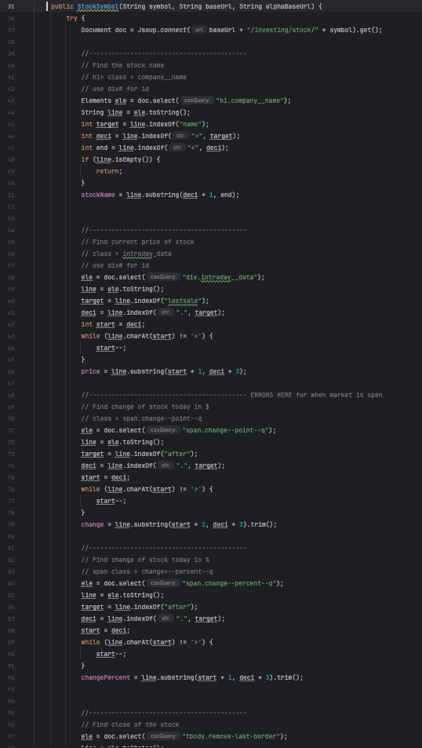
What did we do?
260 LOC -> 17 LOC

Slide 16
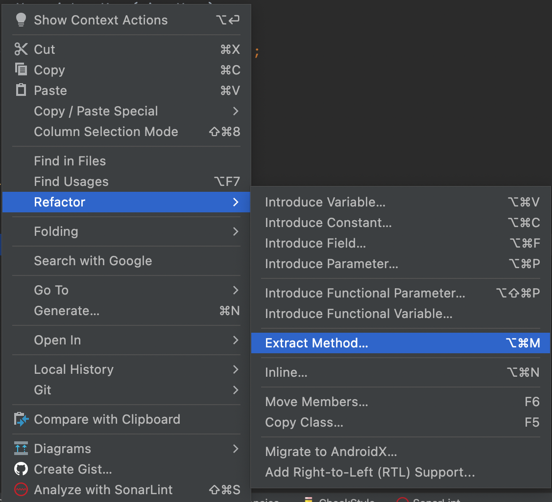
Extract Methods

Slide 17
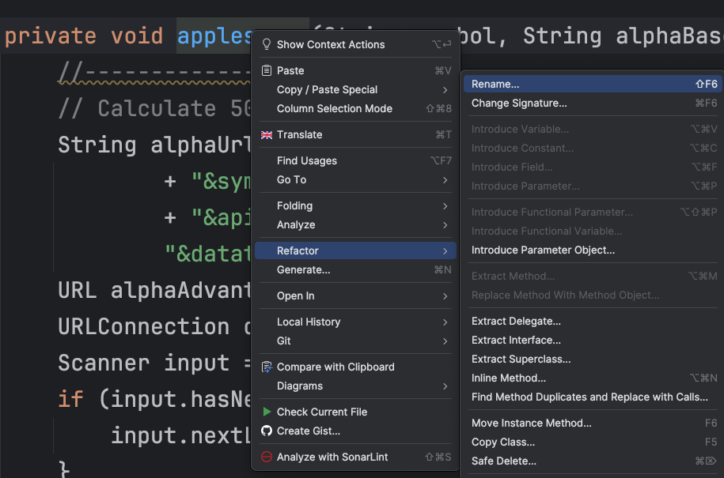
Improve names over time

Slide 18
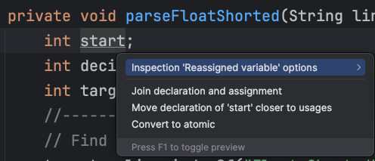
Quick fixes:
Move closer to usages

Slide 19
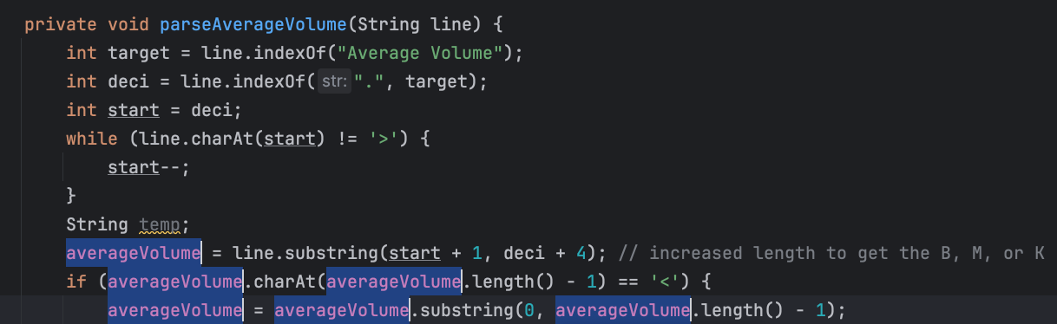
Use temp variable to extract

Slide 20
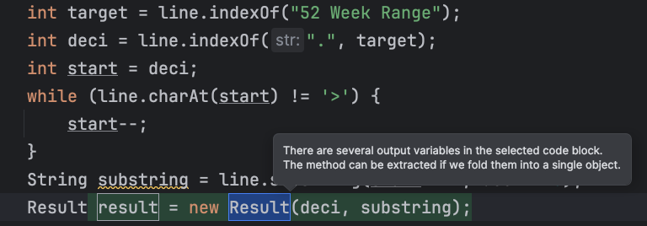
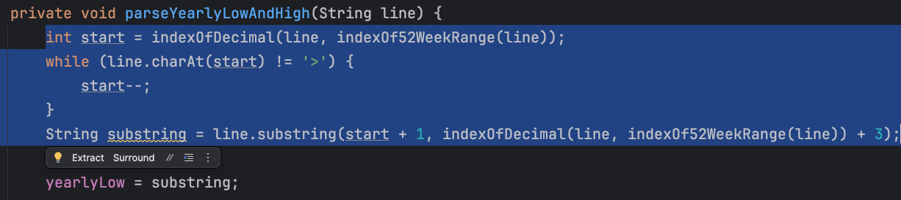
Replace temp with query

Slide 21
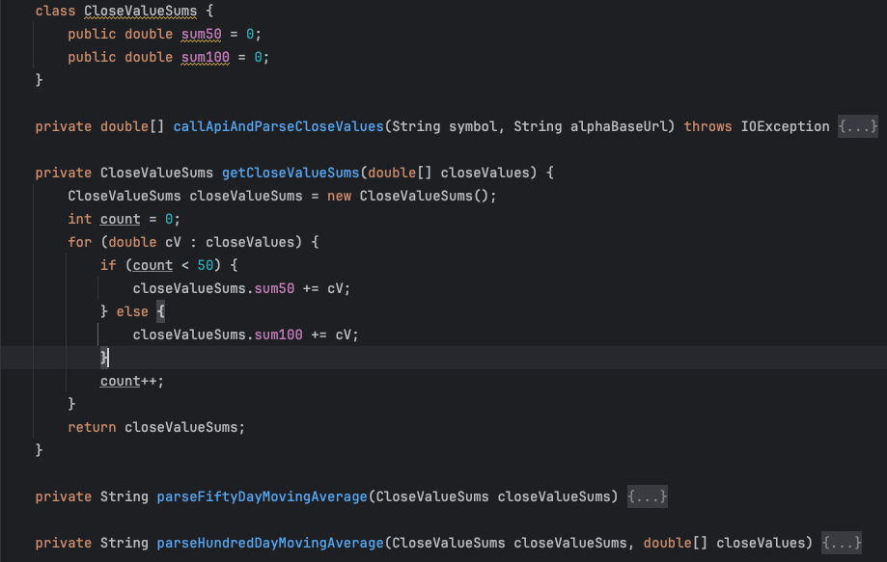
Extract method that returns multiple values

Slide 22
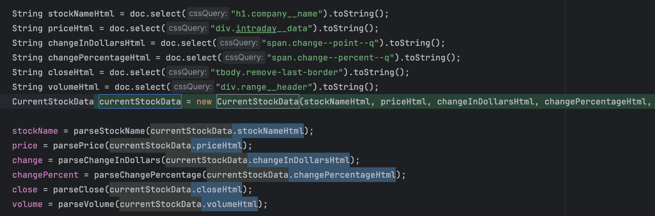
Separate I/O from business logic

Slide 23
Practice, practice, practice!
Deliberate practice -> steps become automatic
Practice on katas before applying to your codebases
Share these ideas with your team and learn together
Try scratch refactoring on your codebases at work

Slide 24
Resources
Sparrow Decks
Long Methods Guided Learning Hour
Naming as a process
Refactoring Katas
Tennis Refactoring Kata Playlist
Demo Code on Github

